Slide 1
Open authoring in Microsoft Azure: Content collaboration across disciplines
Ralph Squillace
ralph.squillace@microsoft.com; @ralph_squillace
Deck: https://github.com/squillace/presentations/idw2015/
Senior (means “old”) Content Developer (What?)
Microsoft Cloud + Enterprise (must be large)

Slide 2
This:
Opensource tooling drives internal and community collaboration
It’s the only way to improve quality and quantity at Internet scale

Slide 3
Kliff’s™ Notz™ Bullets slide
Setting the Table: MSDN and la scuola vecchia
The Bubble Crash and the explosion of words
What we’re doing with Azure.com
Doing it right, and dodging the Dragons.

Slide 4
Where I’m going today… (who cares, right?)
2:00pm-2:45pm DocOps — The Analytical Window to Your Customer’s Experience: Donner (1st floor)
2:00pm-2:45pm Boost Your Content Strategy for REST APIs: Cascade Room (1st floor)
3:00-3:45 pm Work Smarter Not Harder - Remove the Guesswork from Content Creation: Donner (1st floor)
4:00-4:45 pm Money Talks: How Content Strategy Can (Literally) Prove its Worth: Sierra Room (1st floor)
5:00-5:30 pm Working Together - When Content Quality Really Matters: Cedar/Pine/Fir Ballroom (2nd floor)
5:30-7:00 pm Cocktail Reception… um, yes.

Slide 5
Setting the Table
Let’s catch up to that crusty old Microsoft corporation….

Slide 6
When we last left our hero…
It was publishing developer content on MSDN/Technet
Custom XML authoring environment based on Word™®©
Collaboration was in Word revisions and sharepoint and… hindered. (I believe “vetus-schola” is the Latin term…)
Releasing typically every three months…
Conversion from XML to HTML was massive undertaking….
And, of course, standardizing on styles, javascript features, and so on….
Pipeline was custom software
Expensive to build
More expensive to maintain
Per Dilbert specifications, it was out of date prior to release.
And then...

Slide 7
The Bubble pop and the explosion of words
Community-written software demonstrated quality and scale
Speed of features increased radically (Apple, Google, FB, Amazon)
Huge new audiences sizes (Windows, Linux, Android, Mac, iOS and then there’s this pesky “internet of things” stuff….)

Slide 8
42,664,274 topics …
8 million in English…
Notes:
Just to give you an idea of scale….

Slide 9
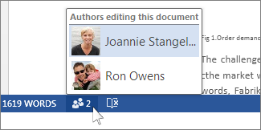

Collaboration: It was great for a lot of work…Really!
But as the number of reviewers and articles grew, eventually…

Slide 10
Every participant had to learn our tools to collaborate. That doesn’t scale.

Slide 11
42,664,274 topics …
Let’s note this again….
8 million in English…

Slide 12
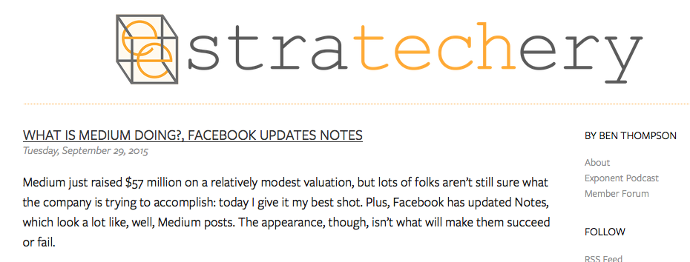
Digression: Opensource and Information Scale-out
Example: medium.com
…I believe [Medium’s] goal is to collate…. If the company can get the long tail to publish on their platform… a massive amount of really crappy posts… a not-insignificant number of really compelling pieces… from a theoretically endless supply of authors… if edited and curated properly… a very compelling stream of content….
That’s part one: the other part is… efficiently done at scale…. A platform that handles everything but the writing could make this path much more accessible…. It’s a vision I’m really excited about, particular the last segment….
https://stratechery.com/2015/what-is-medium-doing-facebook-updates-notes/
Notes:
Where are the “theoretically endless supply of authors”? Hmmmmmmmm

Slide 13
What we’re doing with azure.com
Notes:
An explosion of words. A nebula of words…. Let’s look at just one of those smaller nebulas, the kind that hubble can only see after it eliminates the bright ones…. Azure.com
Take the best improvements in workflow and software and employ them better and faster. Change the way we worked, now.
ONLY open-source collaboration will work. Closed source collaboration, with the same tools, will never produce and manage enough to match the growth in customers for worldwide businesses. At scale, customers always know more and have more time and energy.
Top down commitment in large organizations is required; startups get to work differently.
Investment in automation is its own virtuous feedback loop.
Data tells you what to do, and is part of CI/CD cycle.

Slide 14
Embrace the best and run harder
Internal data center and source-control ➔ https://github.com
Structured XML ➔ markdown
Custom Word-based authoring ➔ Anything that works with text
Windows-only ➔ anything that works with text
Automated validation ➔ different automated validation
Monthly freezes, builds ➔ instant staging, multiple daily publication
Professional writers ➔ Everyone’s a professional writer….

Slide 15
Collaboration is required to match the growth of words
PMs, development, support, and field own formal articles on azure.com
Use the platforms of our customers: Linux and Mac, not just Windows
Data-driven support items become documentation, not “support”
Write documentation now directly with customers and go live
Automation everywhere. EVERYWHERE. MORE. YESTERDAY.
Weekly freshness reviews keep content accurate
Professional writers ➔ Everyone’s a professional writer….

Slide 16
Drive the change from the top
Executive VP Scott Guthrie personally made it his mission
Hosted first two-day hackathon for documentation across all of Cloud and Enterprise: more than 500 people and all product groups in room
Regular “hackadocs” for smaller and more focused needs (freshness, style, metadata)
Hackadocs spreading across the company
Notes:
Anything to add here? Stats? Anecdotes we know?

Slide 17
Automation everywhere
Microsoft has made it a mission
Automation on the client: link checking, metadata, check-in validation
Automation in source control: CI, writer control, CD for staging
Automation in data collection: A|B testing, heat paths, sat/view
Notes:
Anything to add here? Stats? Anecdotes we know?

Slide 18
Data tells you what to do
Data about readers, of course.
Data about topics relative to readers, of course.
Data about clusters of views
Data about reader opinions – what do they vote and say?
Notes:
Anything to add here? Stats? Anecdotes we know?

Slide 19
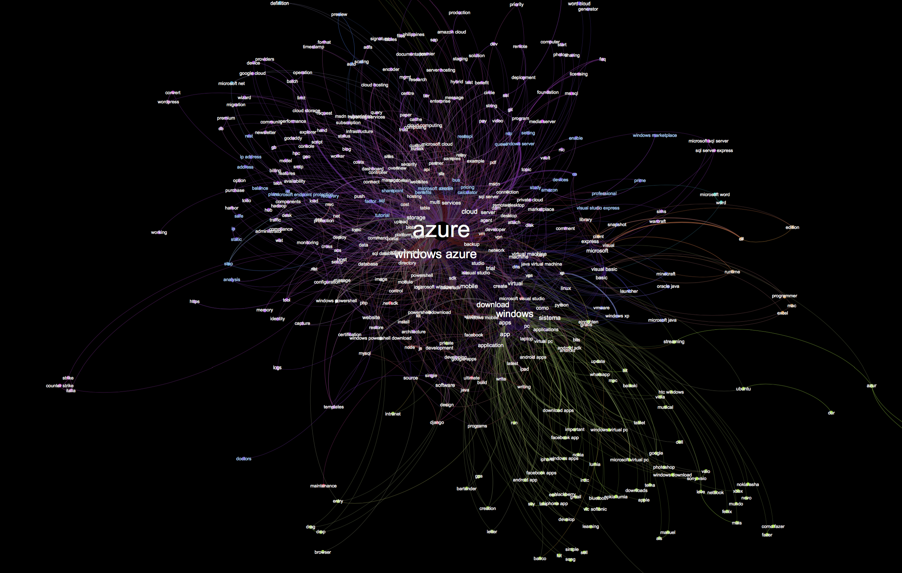

Slide 20
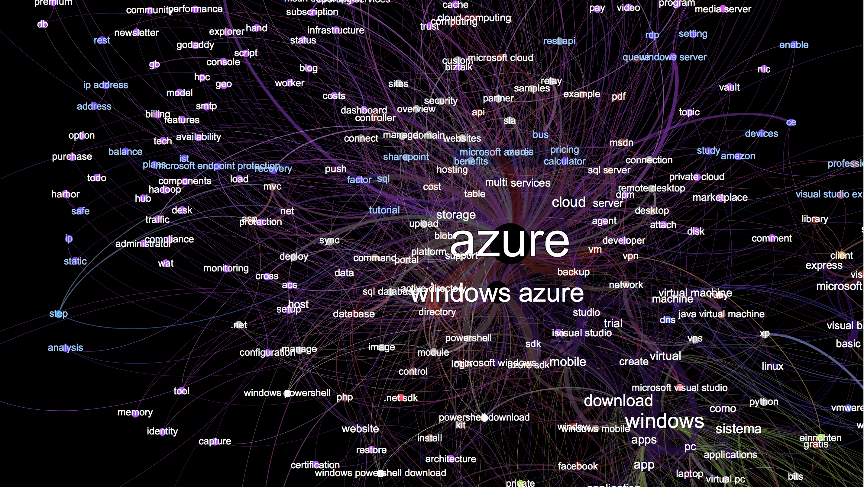

Slide 21
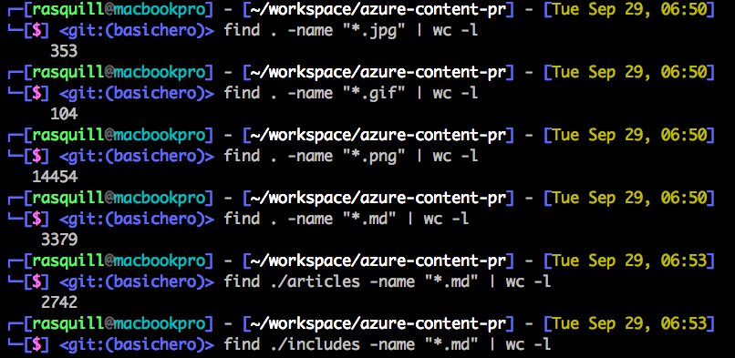
Where we are: https://azure.com
Opensource:
Two repositories on https://github.com: public is https://github.com/azure/azure-content.
File format is markdown, with custom extensions for reuse, standardized javascript, and other special features.
Nothing in the entire toolchain is Windows-only
Authoring in anything that writes markdown.

Slide 22
Who’s committing…
Of course, with dupicates and new accounts, it’s really on the order of about 900 contributions, in a normal distribution, as you’d expect….
3966 Sebastian Durandeu 2830 Molly Bostic 2105 v-aljenk 1891 Dene Hager 1739 Jim Becker 1621 Tyson Nevil 1527 Ross McAllister 1279 C.J. Gronlund 961 unknown 751 ggailey777 741 Ty 678 Tom Dykstra 673 Larry Franks 668 Sreedhar Pelluru 570 David Wrede 524 Jemash 512 Monica Rush 431 SharS 418 Glenn Gailey 416 Andy Pasic 387 pennij 383 Tom FitzMacken 360 CherylMc 351 Matt LaBelle 316 Ralph Squillace 312 Carolyn Gronlund 305 Kathy Davies 286 ShawnJackson 284 Bryan Lamos 279 Juliako 276 Walter Poupore (Microsoft) 273 Joao Madureira 272 jimbe 271 davidwrede 271 Tamra Myers 269 Alan Cameron Wills 265 cherylmc 264 Brian Swan 257 Jonathan Gao 242 Gary Ericson 236 HeidiSteen 236 Bill Mathers 235 Seth Manheim 230 Steve Stein 228 Andy (adegeo) 226 Jeff Stokes 224 Alpa Kohli 221 Dan Lepow 217 tysonn 217 Steve Danielson 217 Ryan Wike 209 Katie Griffith 207 Blackmist 206 Penni Johnson 190 v-kagri 188 cephalin 186 Matthew Henderson 185 Alma Jenks 183 deneha 182 Curtis Love 177 mimig 168 Sigrid Elenga 160 bradsev 157 pcw3187 157 Dhanashri Kshirsagar 155 Tom Archer 155 RickSaling 149 Jim-Parker 146 barbkess 144 Joost de Nijs 142 Patrick Sheahan 139 krisragh 139 Erik Reitan 138 sidneyh 136 ghogen 135 mattshel 135 GeneMi-MightyPen 131 jeffstokes72 130 Donna Malayeri 128 curtand 125 Bill Anderson 122 Telmo Sampaio 120 tfitzmac 119 Mimi Xu 117 Brian Wren 115 v-lincan 113 Stephen Siciliano 111 jessebenson 110 Ken Hoff 109 Christopher Anderson 108 Liza Poggemeyer 106 Jason Roth…..

Slide 23
Dodging the dragons

Slide 24

Dragons

Slide 25
DRAGON: Markdown is not structured.
Markdown is an easy way to type HTML quickly. That’s it.
Notes:
I do not know how to overemphasize this, given the trends in professional writing, building, and publishing over the last 15 years. The open doc formats; DITA – at this conference, has its own track! It **must** be good! (New shimmer…. ☺)

Slide 26

We got this covered. No, really.
Notes:
What’s the attraction here? The attraction is the success that this format has had in getting all kinds of writers to write and have it flow directly into xHTML. Once there, we can do anything with it, and markdown has tons of opensource tools for preprocessing and custom conversion (we make heavy use of this)
Short version:
Markdown converts to xhtml, which IS structured.
Tools ecosystem for markdown and xhtml is massive.
Pandoc for conversion to mostly any other format.
Libraries in every language for everything.
Automation in all things.
Custom widgets validate markdown, prevent corruptions, implement custom transformations.
Every automation investment reduces downstream complaints, fixes, and increases comfort and scale.

Slide 27
DRAGON: Writers not familiar with markdown
Remember teaching them xmetal? Ooxml? DITA? HTML?

Slide 28

Markdown is vastly easier than XML.
Notes:
Turns out teaching them markdown takes all of about a couple of hours, and they’re off and running – most of them within 15 minutes. There are some tricky angles – tables, for example – but there are also already tools for that freely available, and we’ve written tools to convert excel to tables, word tables to tables, and so on.
Short version:
Markdown was created to type HTML more easily. It works.
It requires no special tools or indenting or anything else to read easily compared to xml.

Slide 29
DRAGON: git and github
OK….. Um…
Notes:
Wow. This is an issue. Who knows what “git” is?

Slide 30

Still working on this one, but…
Notes:
Short version:
Extensive training required, because git is a source control system that does not really care about files, which writers – frankly, most humans outside of developers -- think of as golden.
Developers use or understand git very quickly, so in software, that’s a plus….
Customers already use git, and can contribute without training, so we end up authoring in their comfort zone; they could never have contributed in our old comfort zone.

Slide 31
DRAGON: side effect of distributed authoring: merging does not scale out with community
Notes:
Git, however, DOES enable anyone to be working on the same file at the same time. Turns out humans like “locking” files, so they can avoid collisions with the one or perhaps two other people who might be collaborating on that file. That was when we had 100 or more writers and maybe 120 reviewers. Now we have on the order of 900 writers – collisions happen all the time when locking.
But it turns out that this doesn’t matter because **most** changes occur in different parts of the file, so merging is easy, even if six people are working on it at once. However, they occur, and you need someone to be the merger – to make the final decision about who wins with a file. This requires the person merging to know the file, know the people, and know the subject matter.
THIS DOES NOT SCALE from the 100 writers we had before to the 900ish we have now.

Slide 32
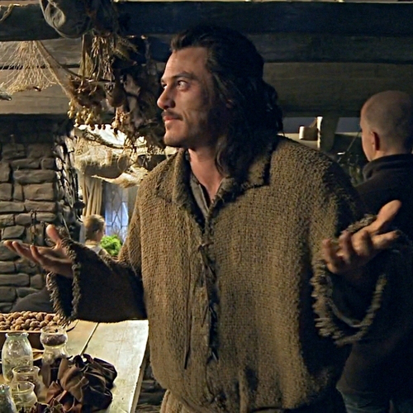
Oh, we got this one…
Notes:
Short version:
In the beginning the writers didn’t have enough knowledge of git to avoid mistakes, so had to get dedicated staff, but…
…even they could not handle the merge load without making mistakes, plus now contributors are committing all over the world, at all hours, so….
…automated validation removed 80% of contribution approvals, enabling smaller, more trained staff to focus on getting the files merged with higher confidence…
…and with more knowledge how to recover from mistakes.
Demo of do-not-merge tags? Validation?

Slide 33
What we’ve learned
Take the best improvements in workflow and software and employ them better and faster.
ONLY open-source collaboration will work.
Top-down commitment in large orgs is required; small is different.
Investment in automation is its own virtuous feedback loop.
Purging low-performing content is as important as anything else at scale.
Notes:
ONLY open-source collaboration will work. Why?
Closed source collaboration, with the same tools, does expand the knowledge base and supports more content, faster, but…
It will never match the growth in customers for worldwide businesses; in addition, it…
Prevents customer intelligence from being applied. At scale, customers always know more and have more time and energy.

Slide 34
A Few Best Practices
Validate structure on checkin; content on client.
CI/CD to staging for instant feedback
Mergers must be professional/highly trained
Saying no when it’s not in the bug list
Destroying topics the owners do not want to top up
Notes:
The last two are not necessarily intuitive. Think about it; it’s a consequence of embracing scale. In the past, who didn’t get bonuses for trying to write ten things, but actually cramming in 14? This creates the sense that you can stretch, you can do it.
And the best of us can; but you cannot always hire the best, and even if you do, for a short while, remember that eventually even they will reach the point where they cannot overacheive without destroying the quality that made them the best. Your business will have hired the best, and forced them to be subpar, simply by pushing more until they could not.
Saying no and then destroying topics forces the company to pay even more attention to the customers’ needs. There is no way around it: a destroyed topic that creates a customer complaint applies energe EXACTLY where the customer wants it. Once the practice is established, there is no longer any attenuation of attention to topics: when the deletion period approaches, collaborating writers pay attention.

Slide 35
Future plans

Slide 36
You can guess from here…
More tools for the writers’ environments
Working towards CI/CD with the live site
More intelligent tools for mergers, specifically
Saying no creates partners; so more “no”
Destroying topics the owners do not want to top up
Reference (swagger.io for REST automation)
Notes:
We get CI/CD with staging right now; but we still go live 2-6 times a day. Ultimately, if the writer is happy, they should be able to push live from staging. This one requires a lot of trust. ☺
Reference is one of the main test cases here, because it’s really the only clear case in which structured authoring is a REAL boon. It’s a boon, but not as much as you’d think over markdown, given the toolset.

Slide 37
Questions?

